Slide 1

Bank Loan Case Study
Trainity Project By Vaishakh Menon

Slide 2
Project Description
Business Objectives
Content
Approach
Tech-Stack Used
Insights
Results

Slide 3
Project Description
As a data analyst for a financial business that specialises in urban Lending, our organisation has to deal with a serious problem: certain clients take advantage of their short credit history, which leads to loan defaults. The goal of the project is to use Exploratory Data Analysis (EDA) to methodically examine data patterns. Our goals are twofold: first, we want to avoid turning away eligible candidates, and second, we want to reduce the default risks brought on by a lack of credit history

Slide 4
Project Description
When a consumer applies for a loan, our business might face the following two risks:
1. If a borrower who can repay the loan is denied, the company loses out on business.
2. The corporation runs the risk of losing money if a loan is approved for a borrower who is unable to repay it.
The available dataset includes information on loan applications that are divided into two categories:
1. Clients having payment issues: These people have at least one early Y loan installment where they have late payments that are more than days past due.
2. All other cases: This group includes situations in which payments were made on time.

Slide 5
There are four possible outcomes when it comes to loon applications:
1. Approvat: The loan request is approved by the employer.
2. Cancellation: if the application is approved, the client may choose to withdraw it.
3. Refusal: The loan request is rejected by the firm.
4. Unused Offer: Even after being approved, the borrower decides not to use the loan.
This project's main goal is to apply exploratory data analysis (EDA) to find out how loan and customer characteristics affect the likelihood of default
Project Description

Slide 6
This project's main goal is to identify trends that point to clients who could have trouble making their installment payments. This knowledge will help with strategic choices on whether to deny loan applications, reduce loan amounts, or provide higher interest rates to applicants who pose a risk. The organization hopes to improve loan approval procedures and make better lending judgements by understanding the main causes of loan defaults
.
Business Objective

Slide 7
We have tables in our databases that provide a lot of information on bank loans. Before running a series of queries to get pertinent data from the database, we carefully examined the dataset.
We clean the data and do various analysis to derive insights. After analysis we do data visualisation of results using graphs and charts.
Approach

Slide 8


Tack-Stack Used
Microsoft Excel
Microsoft Powerpoint
All the tasks and questions are solved by using Excel.
All the solutions are cleanely presented using PPT.

Slide 9
A. Identify Missing Data and Deal with it Appropriately:
We can see many missing data in the loan application dataset. As a analyst, It is essential to handle missing data effectively to ensure the accuracy of the analysis. We have to Identify the missing data in the dataset and decide on an appropriate method to deal with it using Excel built-in functions and features.
Insights

Slide 10
Insights
B. Identify Outliers in the Dataset:
Outliers can significantly impact the analysis and distort the results. We need to detect and identify outliers in the loan application dataset dataset using Excel statistical functions and features, focusing on numerical variables.
C. Analyze Data Imbalance:
Data imbalance can affect the accuracy of the analysis, especially for binary classification problems. Understanding the data distribution is crucial for building reliable models. We need to determine if there is data imbalance in the loan application dataset and calculate the ratio of data imbalance using Excel functions.

Slide 11
D. Perform Univariate, Segmented Univariate, and Bivariate Analysis:
To gain insights we need perform univariate analysis to understand the distribution of individual variables, segmented univariate analysis to compare variable distributions for different scenarios, and bivariate analysis to explore relationships between variables and the target variable using Excel functions and features.
E. Identify Top Correlations for Different Scenarios:
Understanding the correlation between variables and the target variable can provide insights into strong indicators of loan default. We need to segment the dataset based on different scenarios and identify the top correlations for each segmented data using Excel functions.
Insights

Slide 12
Results

Slide 13
A. Identify Missing Data and Deal with it Appropriately
Application Dataset
Previous Application Dataset
Rows
Columns
Rows
Columns
50000
122
50000
36
Null
Null
67
15

Slide 14
Handling Missing Data
Missing Value %
Handling Method
Imputation using Avg or Med for Numerical Values
<40%
Imputation using Mod for Categorical Values
>40%
Remove Columns which is not needed.

Slide 15
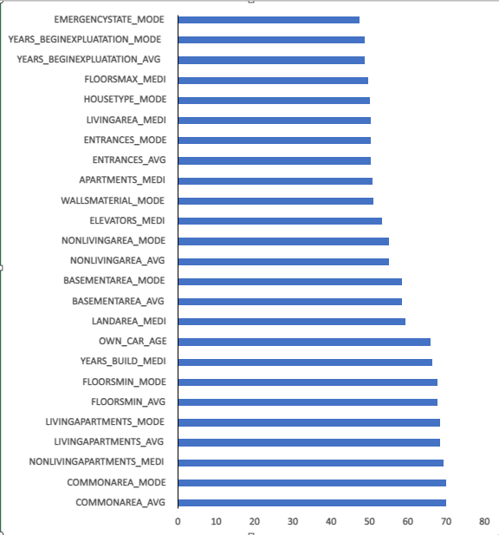
Columns More than 40% Missing Values
There are 25 columns which having missing values more than 40% will be removed from the dataset because it gonna affect our analysis.
Reference :- Excel Sheet

Slide 16
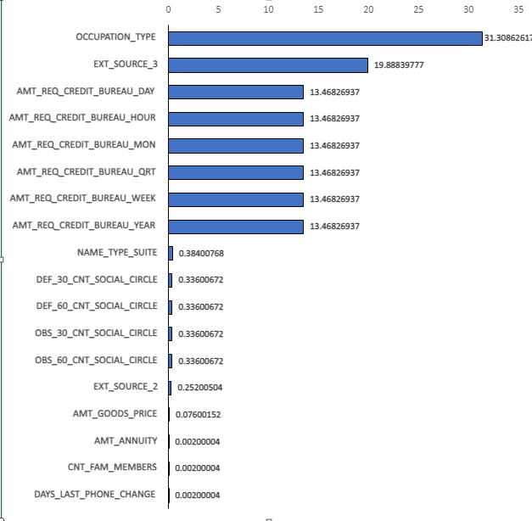
Columns Less than 40% Missing Values
There are 18 columns which having missing values less than 40%, if it’s numerical values we do imputation using average and median and for categorical values we use mode for imputation.
Reference :-Excel sheet

Slide 17
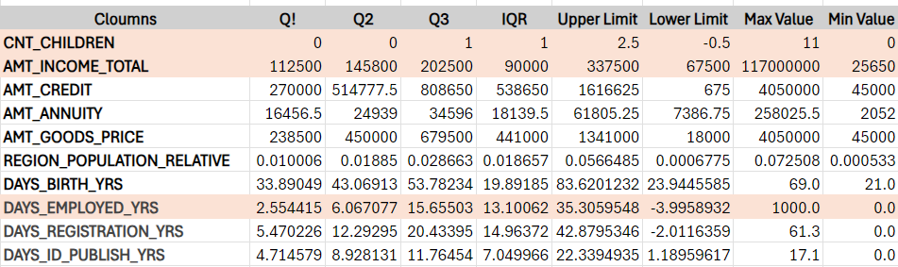
B. Identify Outliers in the Dataset

Slide 18
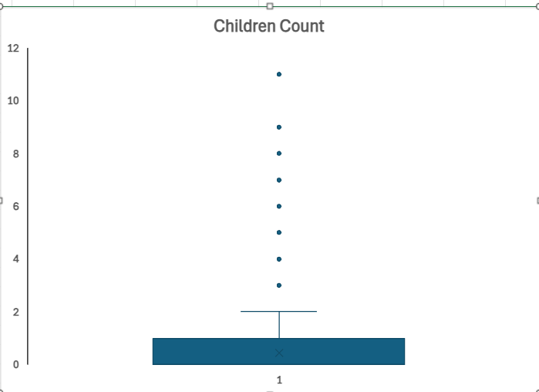
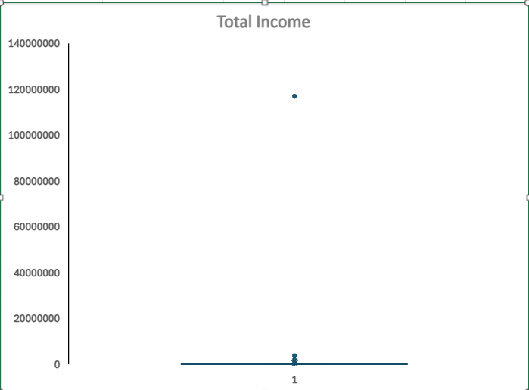
We can see in the box plot that one of the customer having 11 children which is logically not fitting in todays life style. So, we have to re-check the dataset.
We can see in the box plot that one of the customer having total income of 117000000 which is logically not fitting so, we have to re-check the dataset.

Slide 19
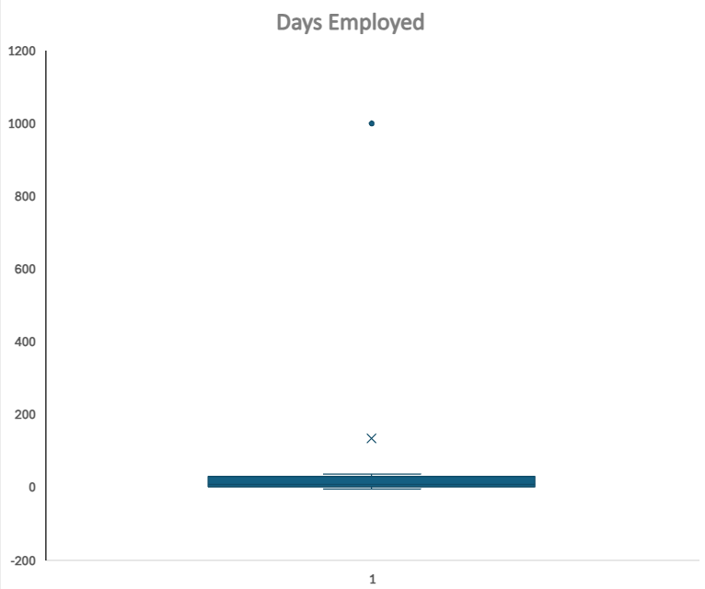
We can see in the box plot that the customers had work for a company for 1000 years which is impossible. So, we have to re-check the dataset.
Reference :-Excel Sheet

Slide 20
After removing all the ouliers from dataset which gonna affect our analysis the final dataset having 41073 rows and 73 columns for further analysis.
Reference :- Excel Sheet

Slide 21
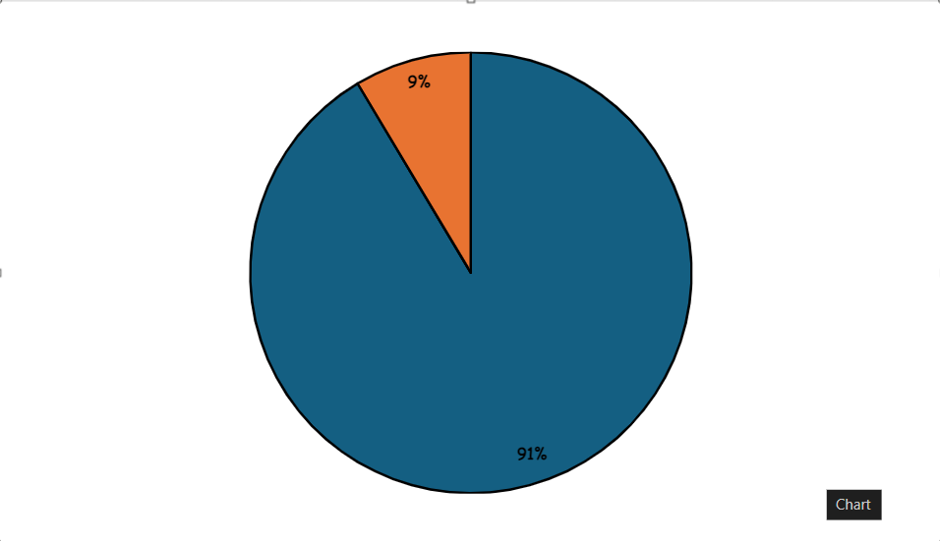
C. Analyze Data Imbalance
Payement Difficulties
Payement Difficulties
No payement Difficulties
3520
37552
Data Imbalance Ratio
10.66818182
Reference :- Excel Sheet
No payement Difficulties

Slide 22
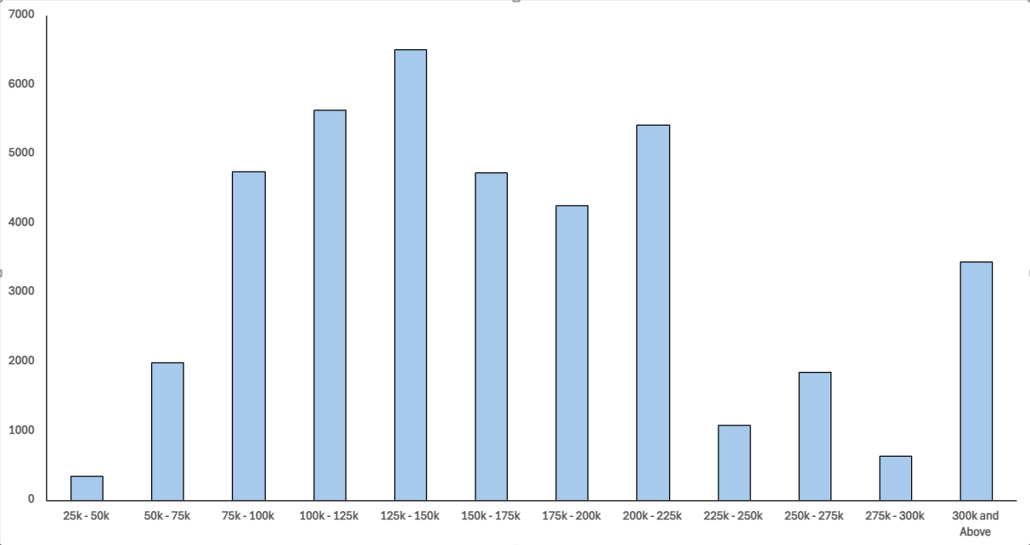
D. Perform Univariate, Segmented Univariate, and Bivariate Analysis
Income Range vs Loan Applicants
As per the chart we can see that the more loan applicants (6508) are comes under the income range of 125k - 150k.
Reference :- Excel sheet

Slide 23
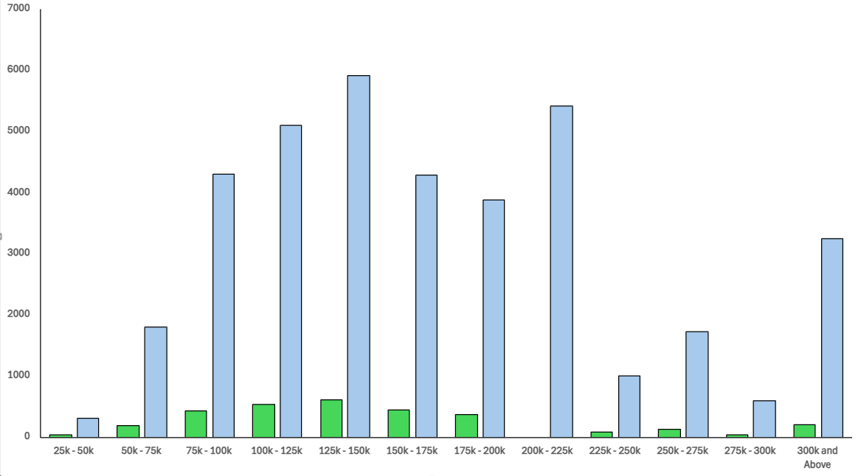
Income Range vs Defaulters vs Non-Defaulters
As per the chart we can conclude that there are 0 loan defaulters in the income range of 200k - 250k.
D. Perform Univariate, Segmented Univariate, and Bivariate Analysis

Slide 24
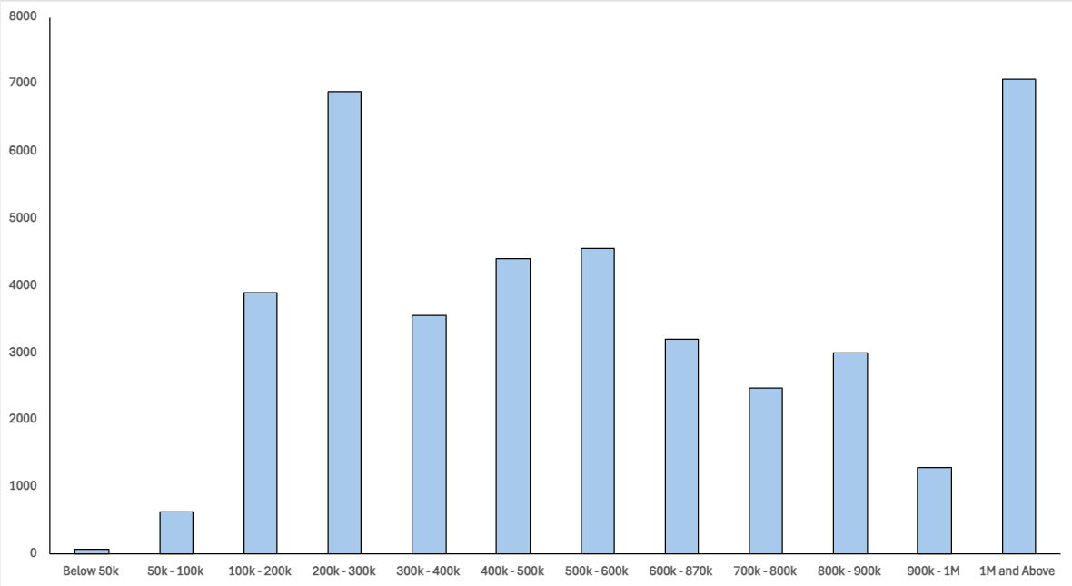
Credit Range vs Loan Applicants
As per the chart we can see that 7086 applicants comes under the credit range of 1M and above.
D. Perform Univariate, Segmented Univariate, and Bivariate Analysis

Slide 25
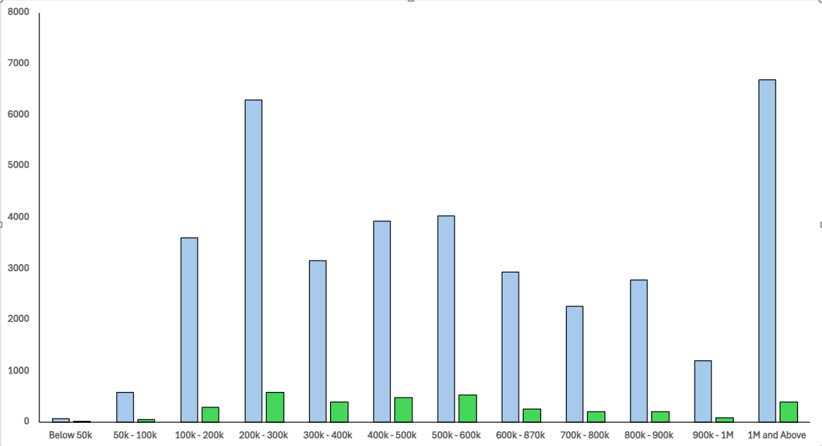
Credit Range vs Defaulters vs Non-Defaulters
In the range of 200k - 300k, we can see that there are max ratio of defaulters.
D. Perform Univariate, Segmented Univariate, and Bivariate Analysis

Slide 26
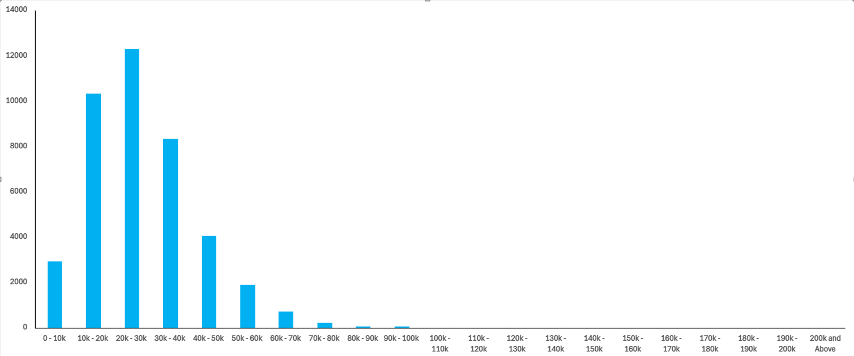
Annuity Range vs Loan Applicants
D. Perform Univariate, Segmented Univariate, and Bivariate Analysis

Slide 27
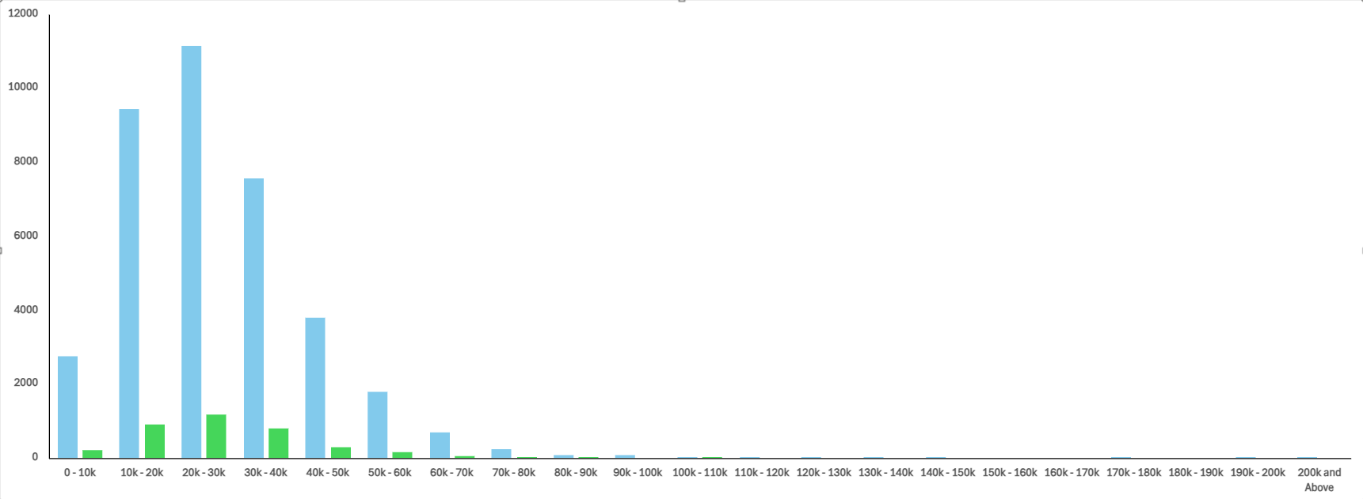
Annuity Range vs Defaulters vs Non-Defaulters
D. Perform Univariate, Segmented Univariate, and Bivariate Analysis

Slide 28
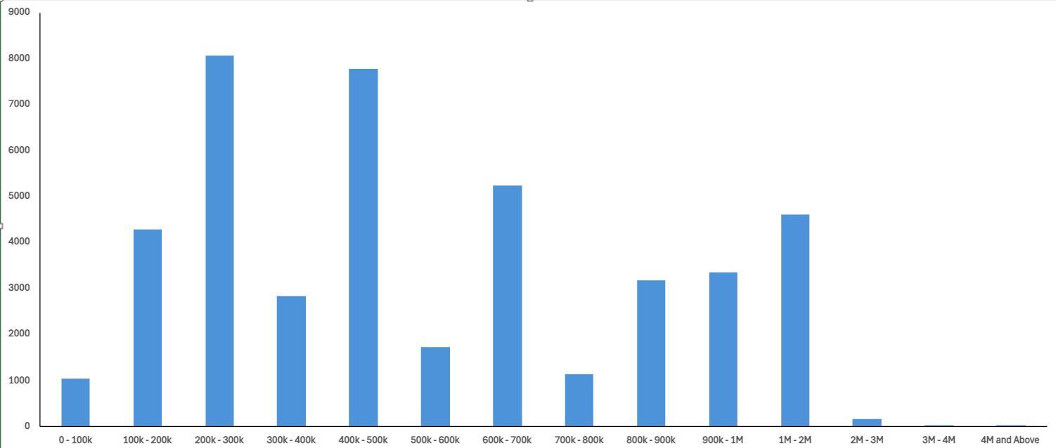
Goods Price Range vs Loan Applicants
D. Perform Univariate, Segmented Univariate, and Bivariate Analysis

Slide 29
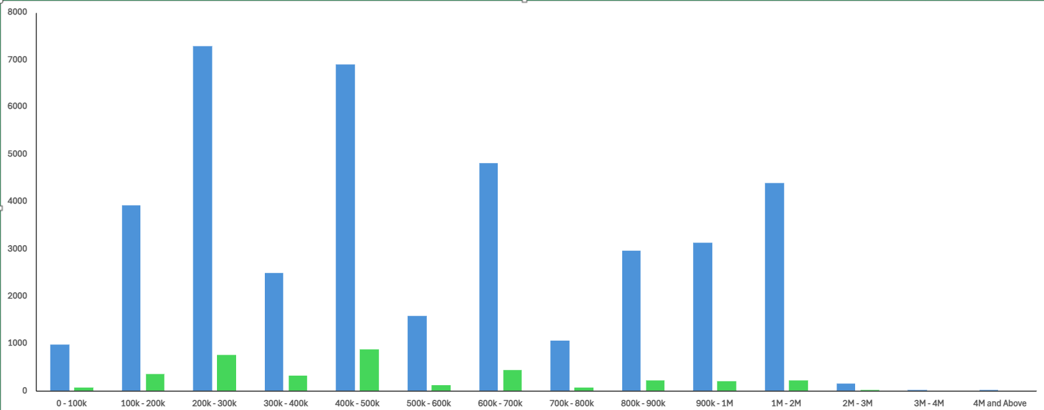
Goods Price Range vs Defaulters vs Non-Defaulters
D. Perform Univariate, Segmented Univariate, and Bivariate Analysis

Slide 30
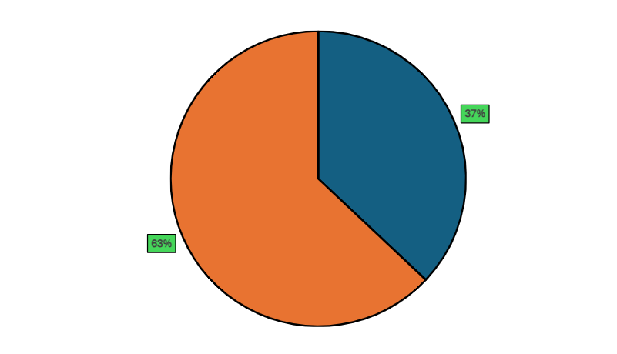
Ratio of Male/Female in Non-Defaulting Loan
Male
Male
13900
Female
23650
Female
D. Perform Univariate, Segmented Univariate, and Bivariate Analysis

Slide 31
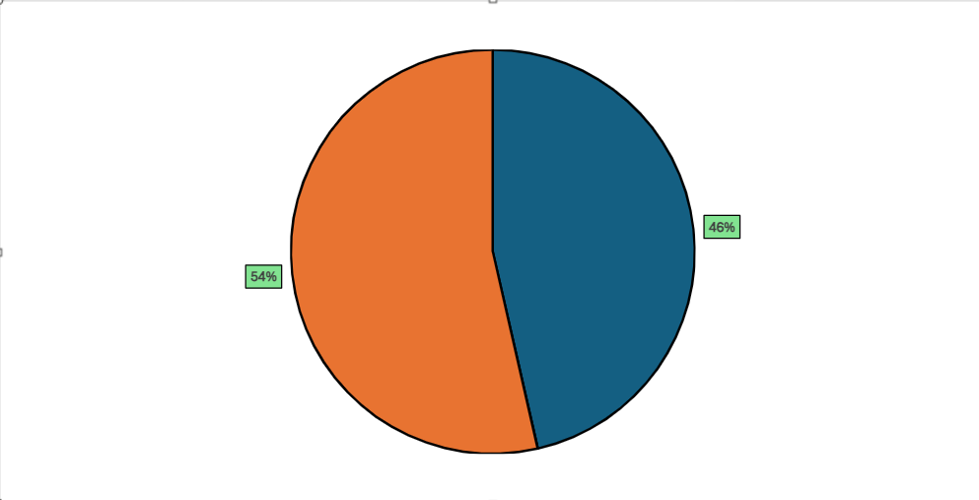
Ratio of Male/Female in Defaulting Loan
Male
Male
1634
Female
1886
Female
D. Perform Univariate, Segmented Univariate, and Bivariate Analysis

Slide 32
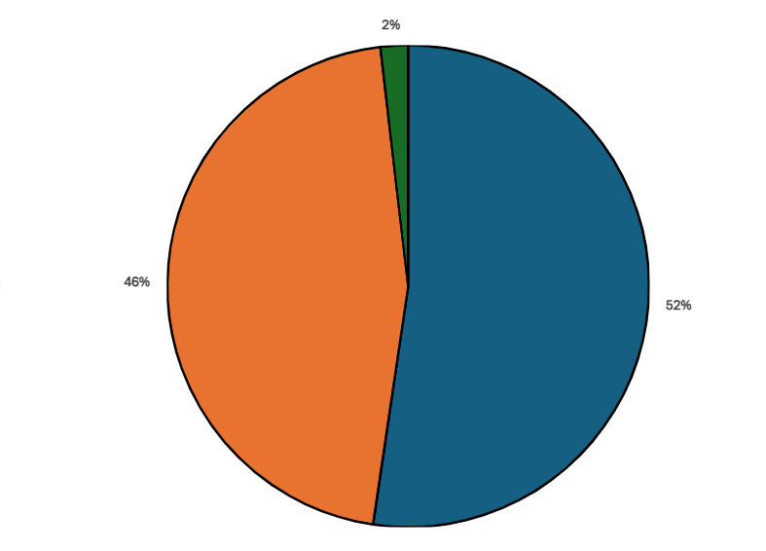
Applicants as per Age Groups
Old
Age
Stages
Young
20 - 40
Young
41 - 60
Middle
61 above
Old
Young
Middle
Old
20717
18139
730
Middle
D. Perform Univariate, Segmented Univariate, and Bivariate Analysis

Slide 33
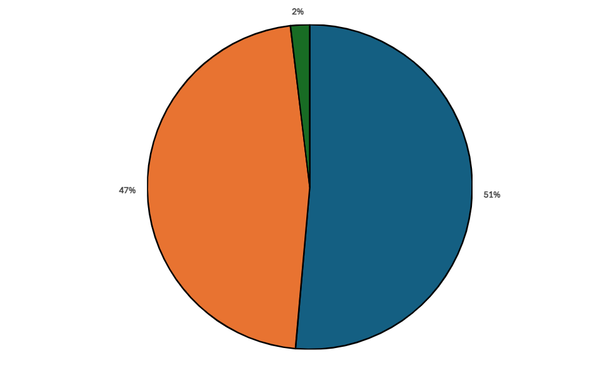
Non-Defaulters as per Age Groups
Old
Age
Stages
20 - 40
Young
Young
41 - 60
Middle
61 above
Old
Young
Middle
Old
18589
16884
690
Middle
D. Perform Univariate, Segmented Univariate, and Bivariate Analysis

Slide 34
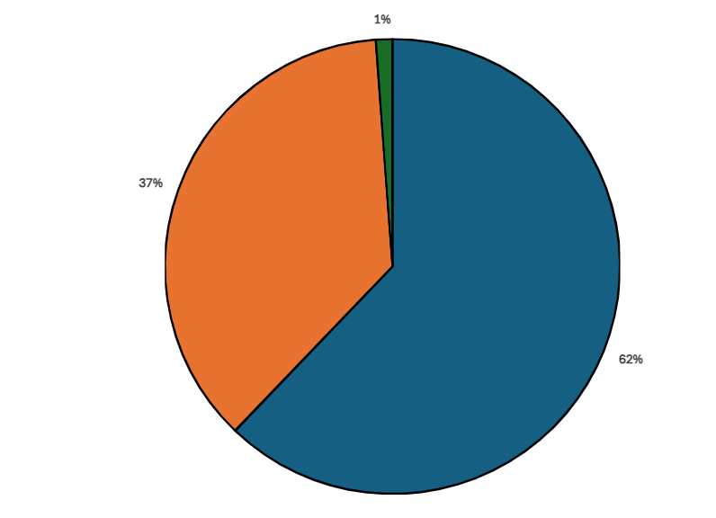
Defaulters as per Age Groups
Old
Age
Stages
Young
20 - 40
Young
41 - 60
Middle
61 above
Old
Young
Middle
Old
2128
1255
40
Middle
D. Perform Univariate, Segmented Univariate, and Bivariate Analysis

Slide 35
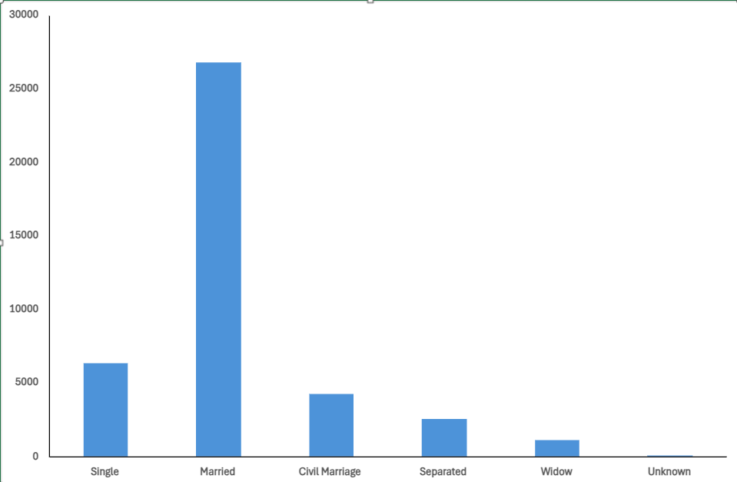
Family Status vs Loan Applicants
As per the chart we can see that maximum applicants those are taking loans are married.
D. Perform Univariate, Segmented Univariate, and Bivariate Analysis

Slide 36
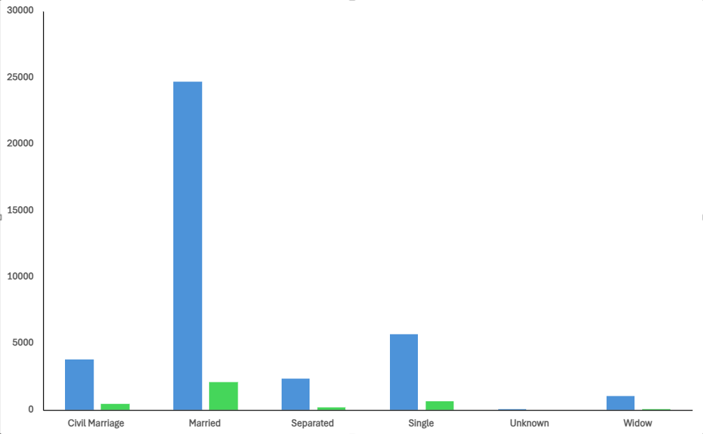
Family Status vs Defaulters vs Non-Defaulters
D. Perform Univariate, Segmented Univariate, and Bivariate Analysis

Slide 37
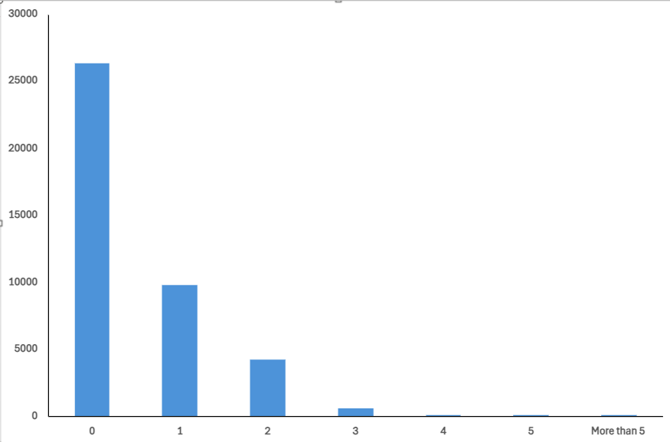
Children Count vs Loan Applicants
D. Perform Univariate, Segmented Univariate, and Bivariate Analysis

Slide 38
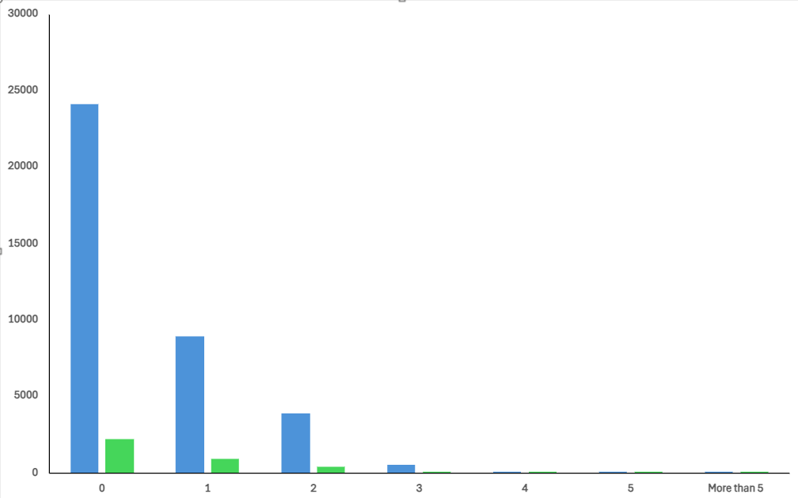
Children Count vs Defaulters vs Non-Defaulters
D. Perform Univariate, Segmented Univariate, and Bivariate Analysis

Slide 39
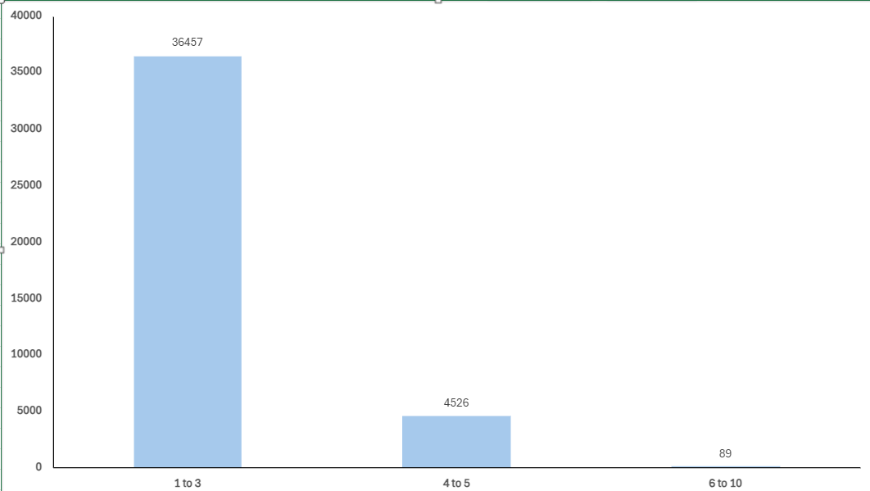
Family Members vs Loan Applicants
D. Perform Univariate, Segmented Univariate, and Bivariate Analysis

Slide 40
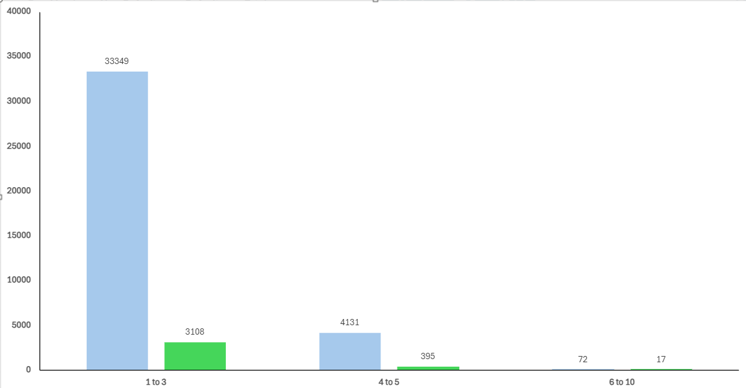
Family Members vs Defaulters vs Non-Defaulters
D. Perform Univariate, Segmented Univariate, and Bivariate Analysis

Slide 41
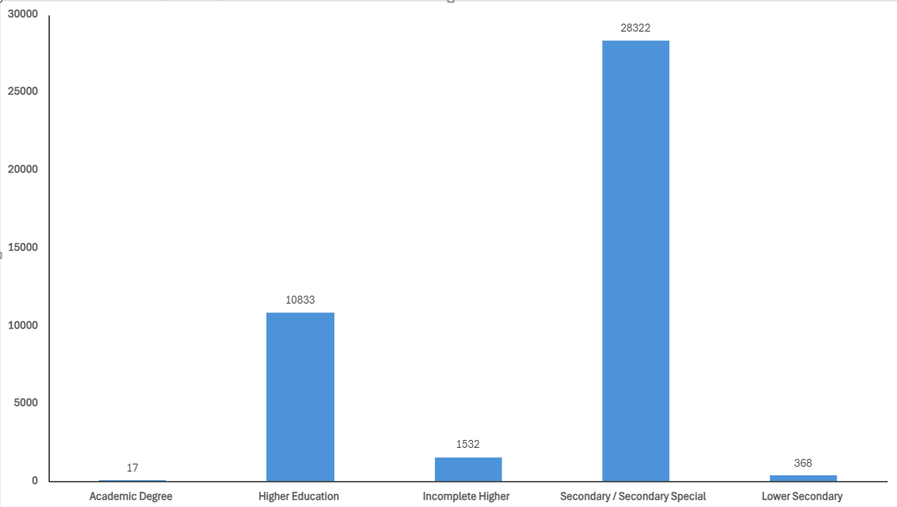
Education vs Loan Applicants
D. Perform Univariate, Segmented Univariate, and Bivariate Analysis

Slide 42
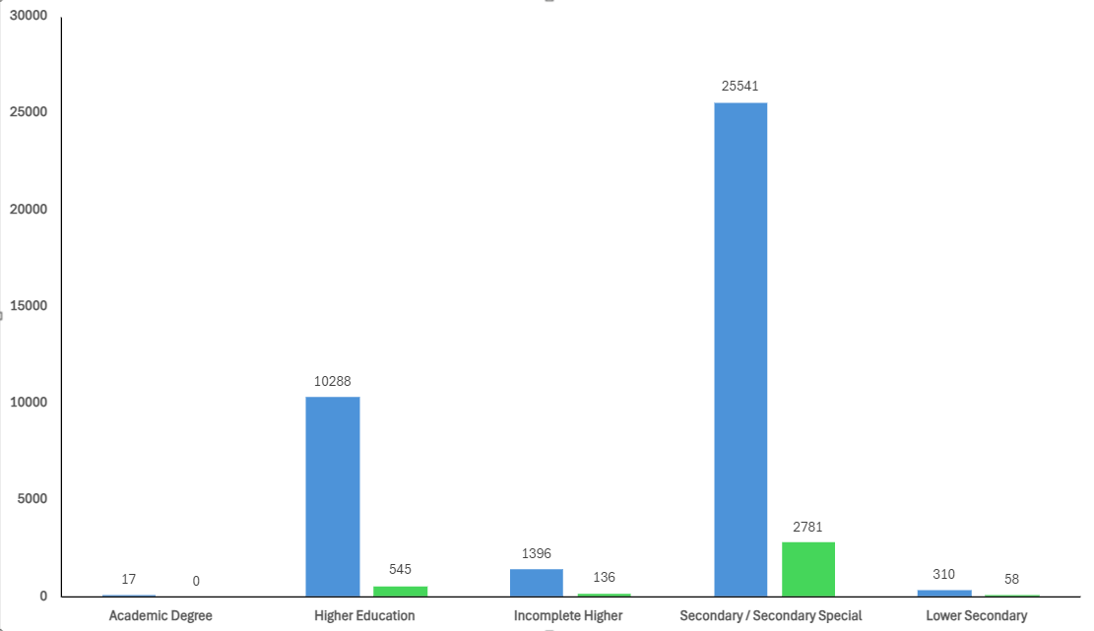
Education vs Defaulters vs Non-Defaulters
D. Perform Univariate, Segmented Univariate, and Bivariate Analysis

Slide 43
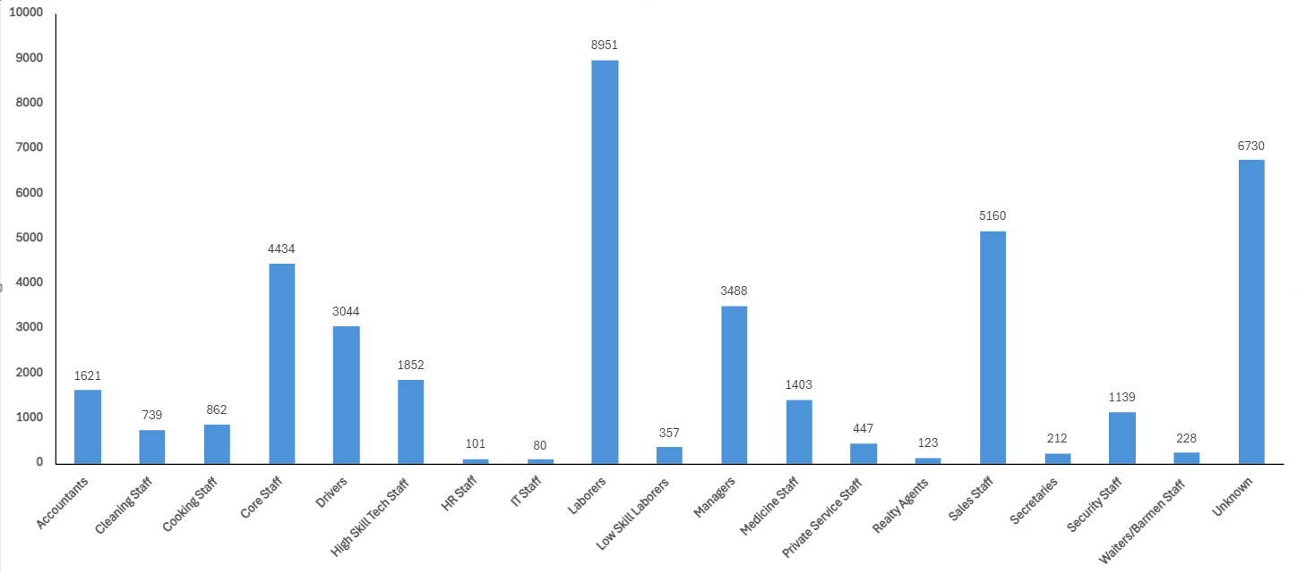
Occupation vs Loan Applicants
D. Perform Univariate, Segmented Univariate, and Bivariate Analysis

Slide 44
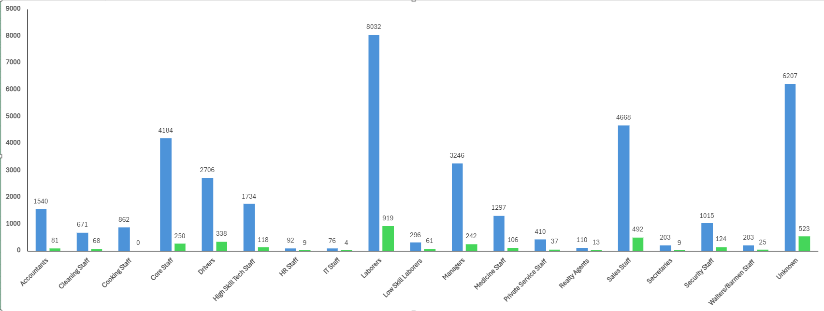
Occupation vs Defaulters vs Non-Defaulters
D. Perform Univariate, Segmented Univariate, and Bivariate Analysis

Slide 45
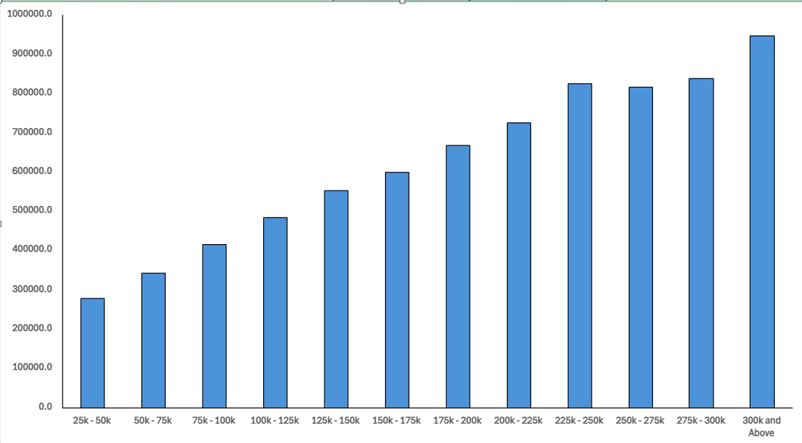
Income Range vs Amount Credit
D. Perform Univariate, Segmented Univariate, and Bivariate Analysis

Slide 46
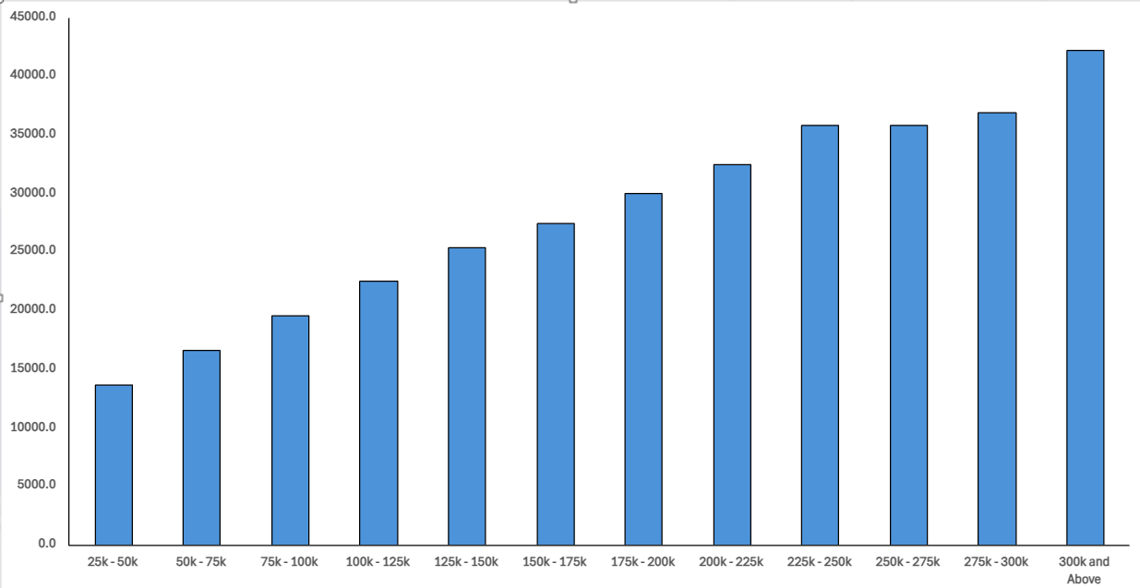
Income Range vs Annuity
D. Perform Univariate, Segmented Univariate, and Bivariate Analysis

Slide 47
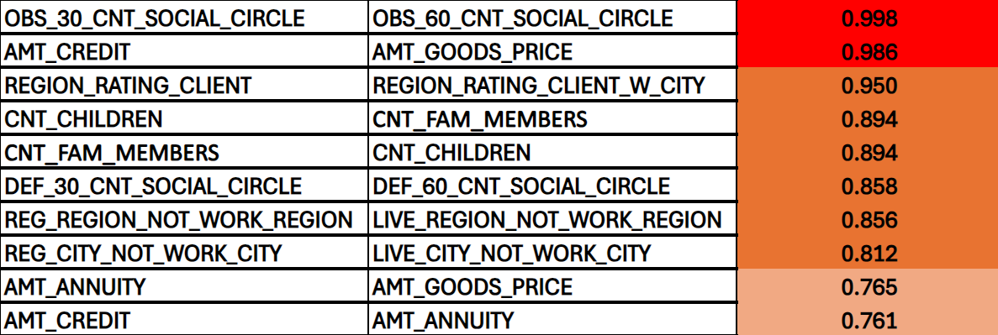
E. Identify Top Correlations for Different Scenarios
Top Correlation for Non-Defaulters
Reference :- Excel Sheet

Slide 48
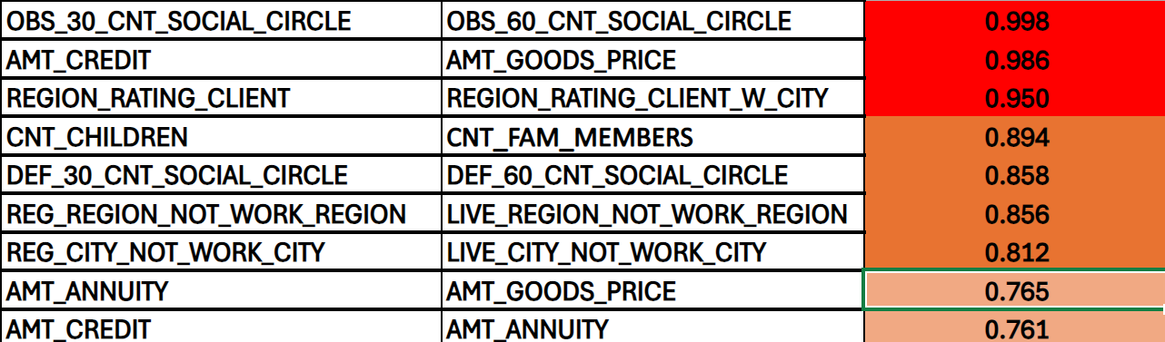
E. Identify Top Correlations for Different Scenarios
Top Correlation for Defaulters

Slide 49
Thank You

